Slide 1
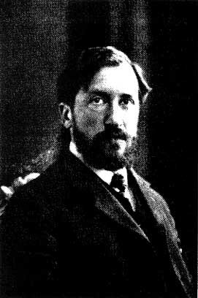
Piet Mondrian
1872–1944

Slide 2
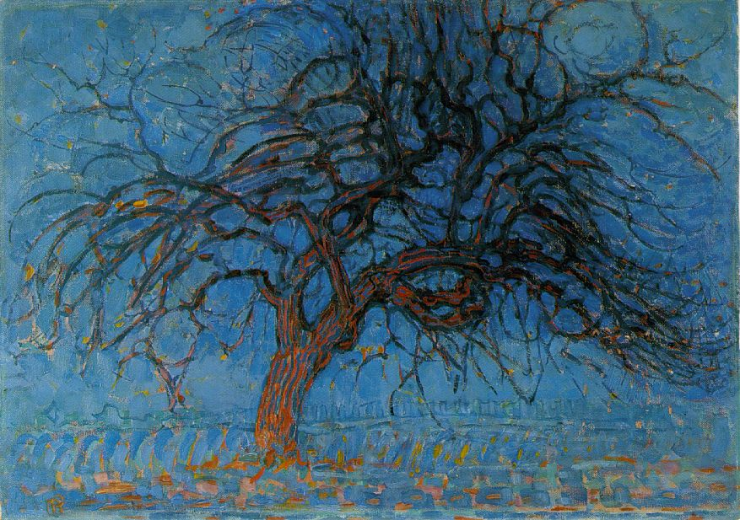
Red Tree
1908
Oil on Canvas

Slide 3
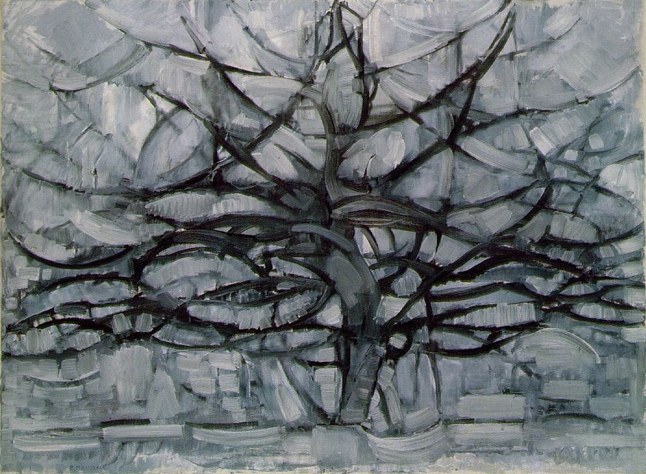
Gray Tree
1911
Oil on Canvas

Slide 4
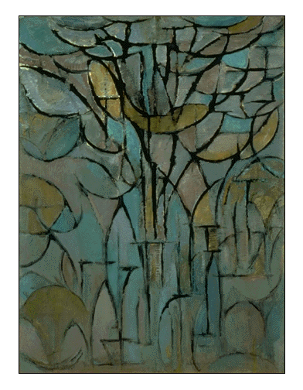
Trees
1912 Oil on canvas

Slide 5
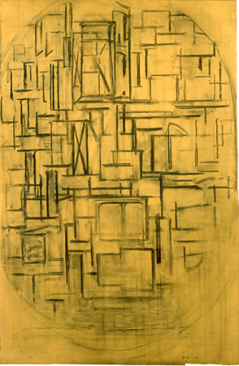
Untitled (Oval Composition)
1914 Charcoal on paper, mounted on panel

Slide 6
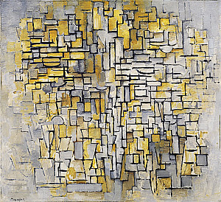
Tableau No. 2/Composition No. VII
1913
Oil on canvas

Slide 7
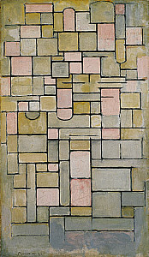
Composition 8
1914
Oil on canvas

Slide 8
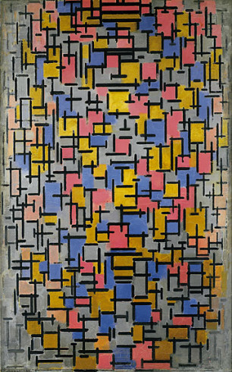
Composition
1916
Oil on canvas, with wood

Slide 9
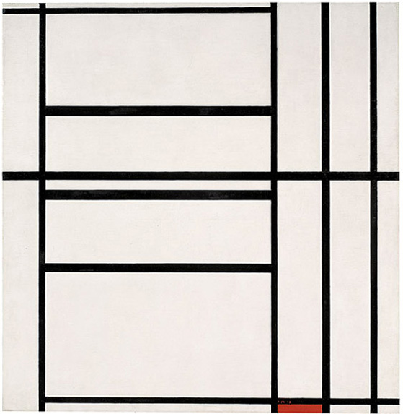
Composition No. 1 with Grey and Red 1938 /
Composition with Red 1939, 1938-39
Oil on canvas mounted on wood

Slide 10
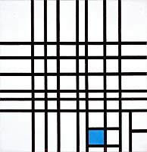
Composition No. 12 with Blue
1936-1942 Oil on canvas

Slide 11
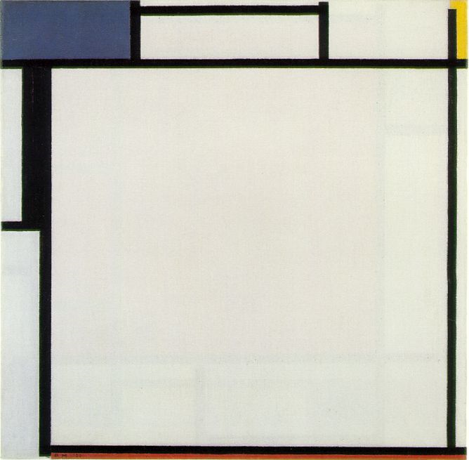
Composition with Blue, Yellow, Black, and Red
1922
Oil on Canvas

Slide 12
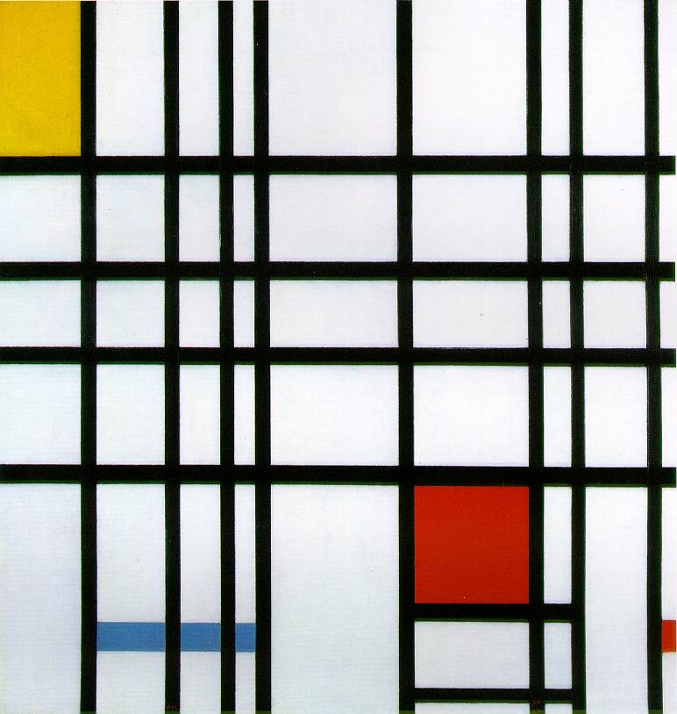
Composition with Yellow, Blue and Red
1937-42
Oil on canvas

Slide 13
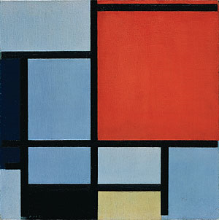
Composition
1921 Oil on canvas

Slide 14
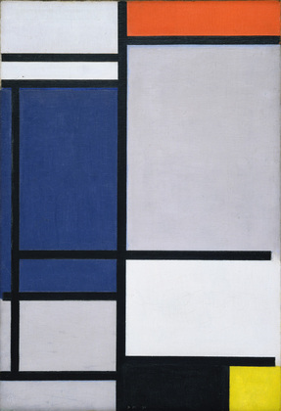
Composition with Red, Blue, Black, Yellow, and Gray
1921
Oil on canvas

Slide 15
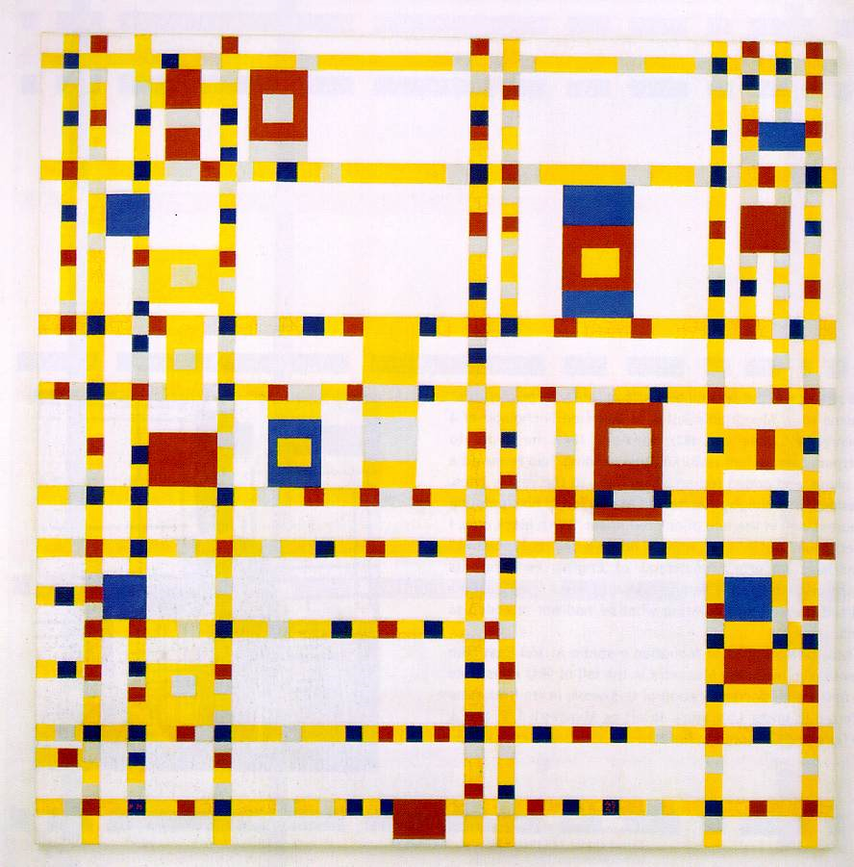
Brodway Boggie Woggie
1942-1943
Oil on Canvas

